Slide 1
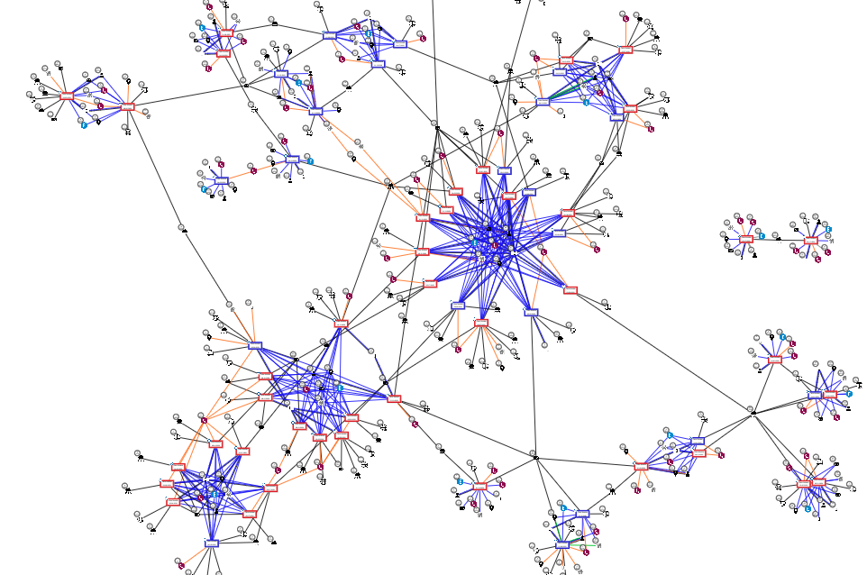
Not All Visualizations are Created Equal
Julie Fisher
October 20, 2020

Slide 2
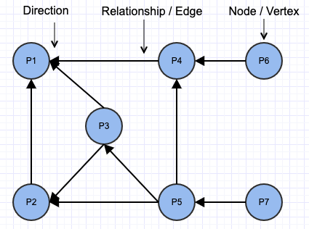
Prerequisites Terminology
Wanda
Tony
Pepper
Knows
Manages
Keeps tabs
Natasha
Friends
Tolerates
Friends
Friends
Clint
Steve
Peggy
Knows
Inspires

Slide 3
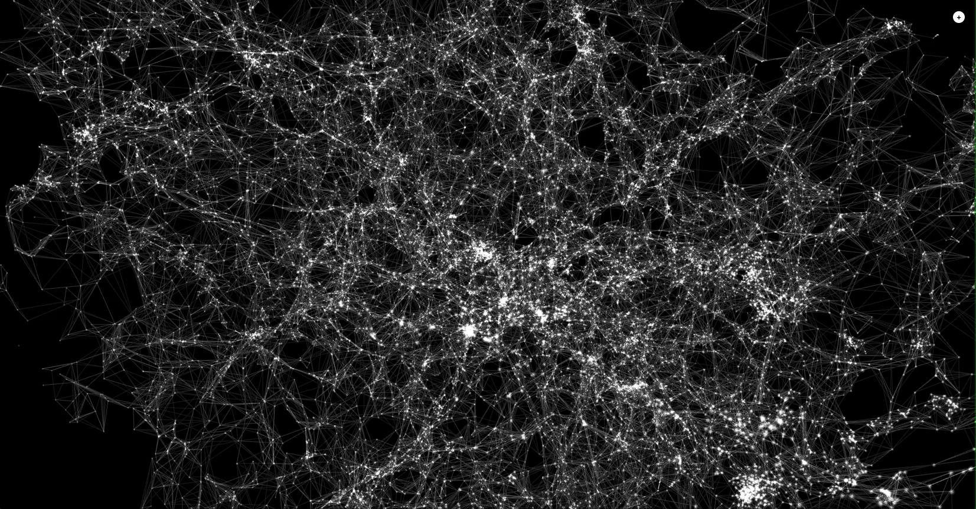
What We Want The Cosmic Web
http://cosmicweb.barabasilab.com/

Slide 4
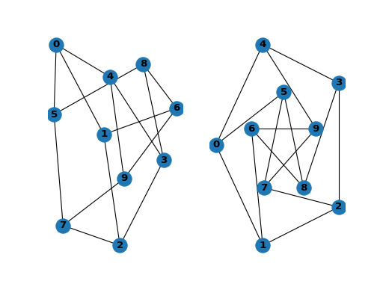
What We Get Super Basic
NetworkX: Drawing graphs

Slide 5
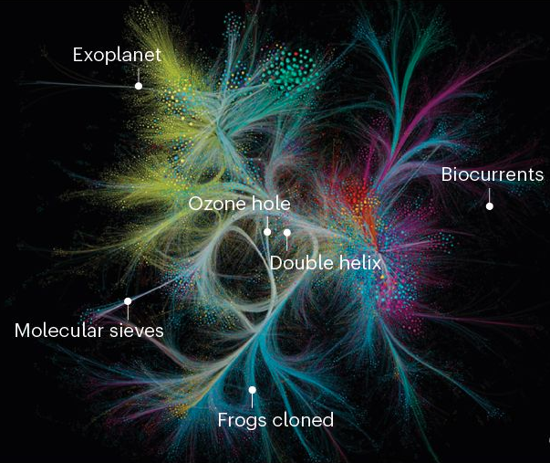
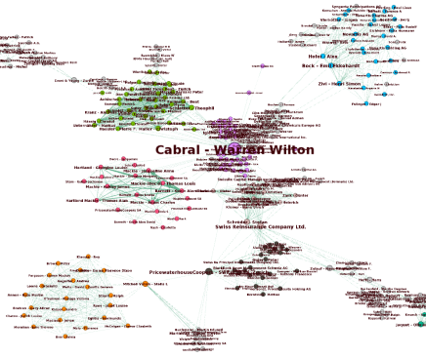
What We Expect Beautiful with Clear Groupings
Nature’s reach: narrow work has broad impact
Paradise papers analysis with Neo4j

Slide 6
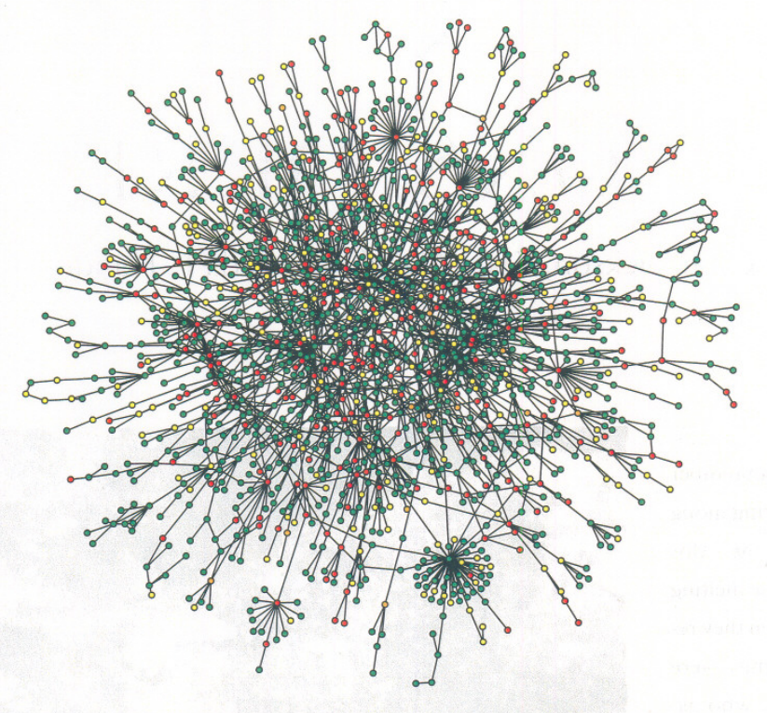
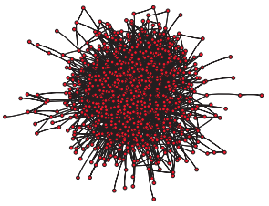
What We Get Tangled and Chaotic
Hierarchical Organization of Modularity in Metabolic Networks
Scale Free Networks

Slide 7
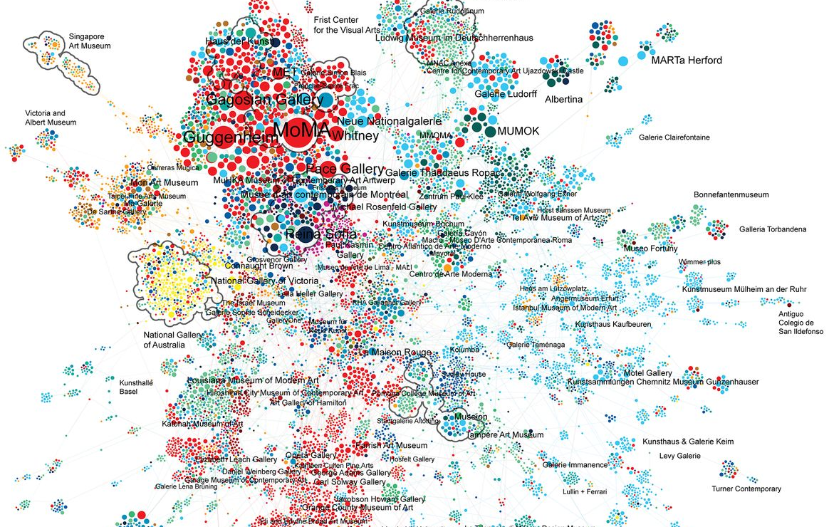
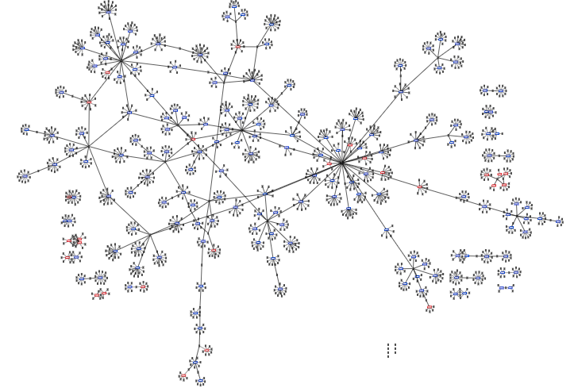
Publication Ready vs Functional Reality
Quantifying reputation and success in art
Publishable
Functional

Slide 8
The Human Disease Network
Publication Ready
Professional designer creates a clear and pretty display
Data and findings known

Slide 9
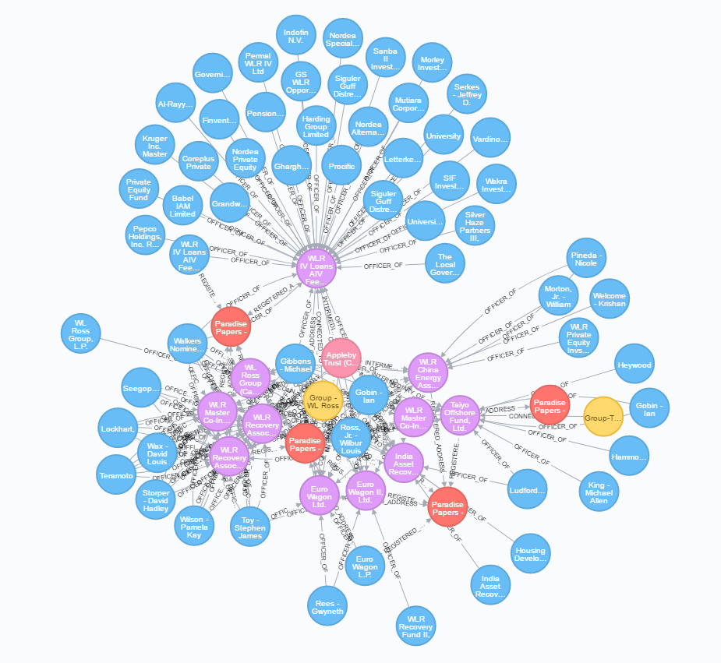
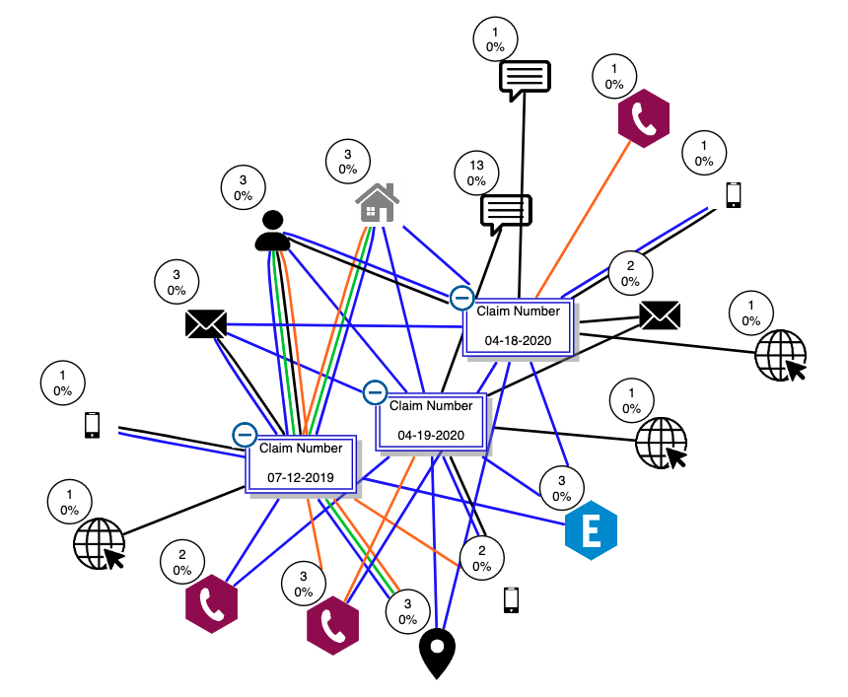
Functional Reality Investigation and Exploration
Investigation
Visualization created using Neo4j’s browser
Exploration
Visualization created using Tom Sawyer

Slide 10
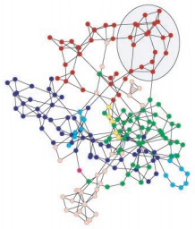
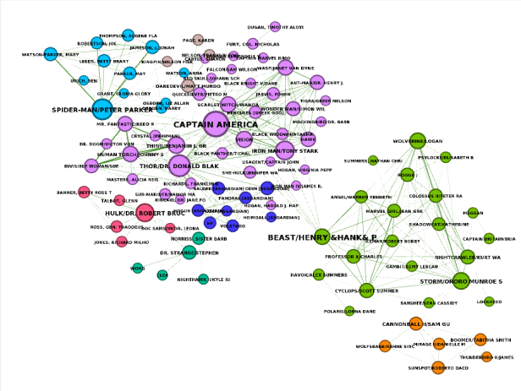
Functional Reality Investigation and Exploration
Hierarchical Organization of Modularity in Metabolic Networks
Neo4j Marvel Social Graph Algorithms Community Detection

Slide 11
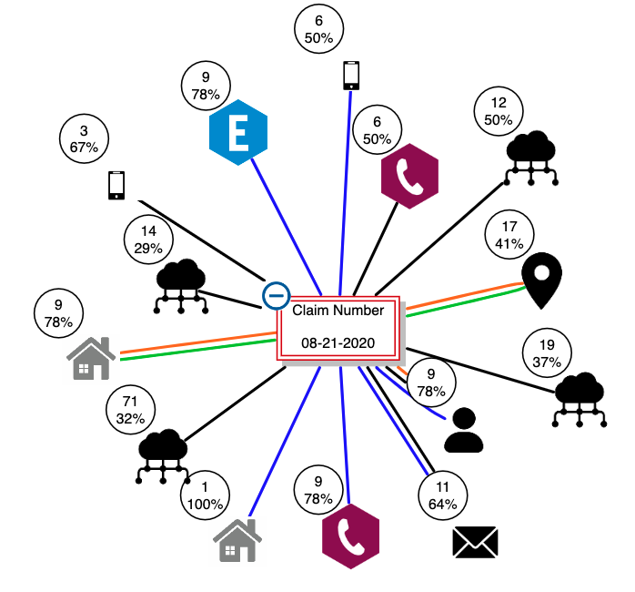
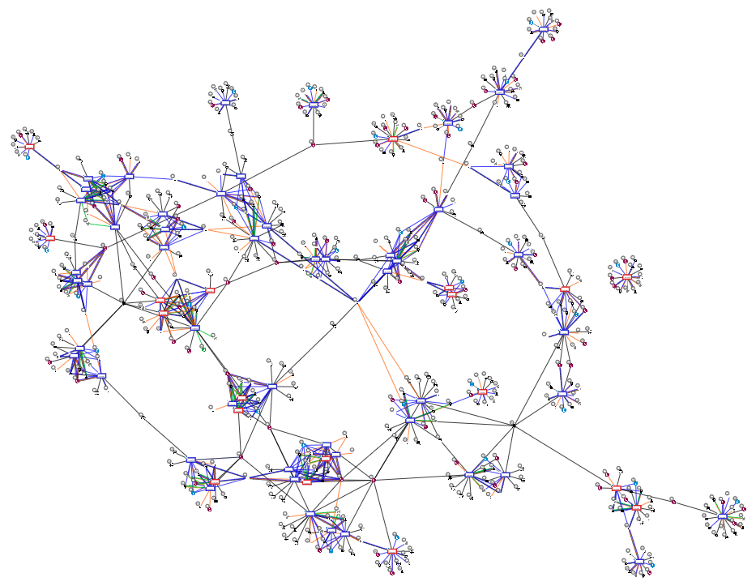
Investigation
Targeted and focused
Starts with a small specific node set
Expands to related nodes

Slide 12
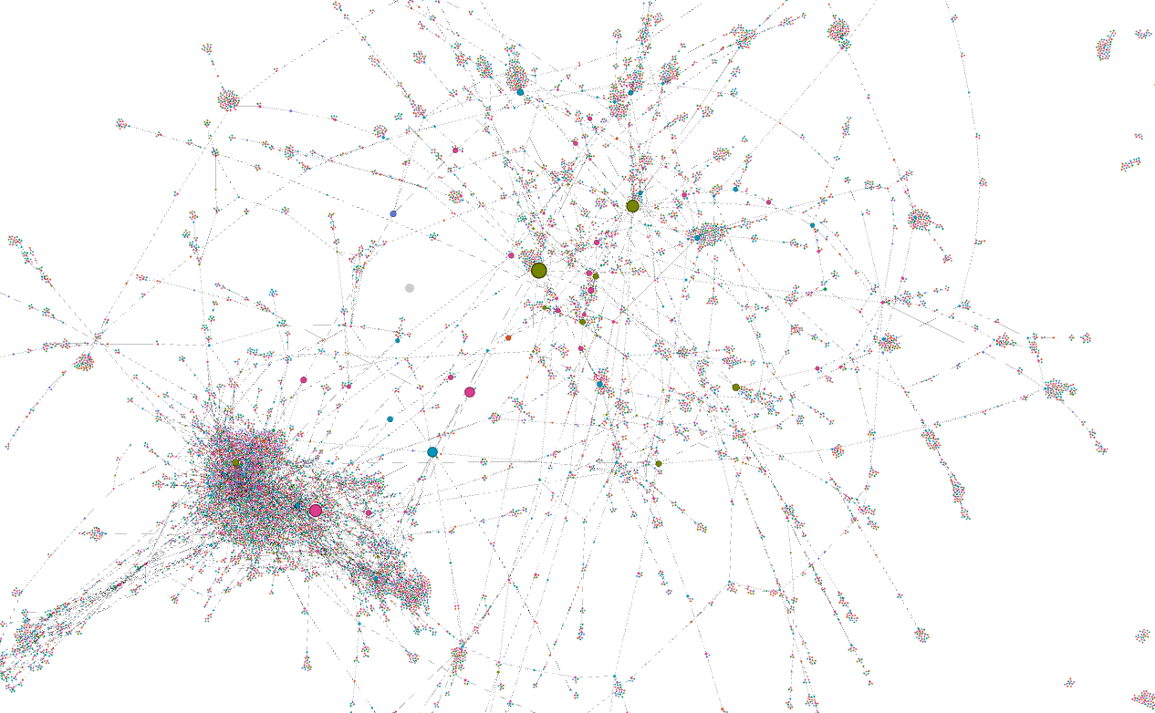
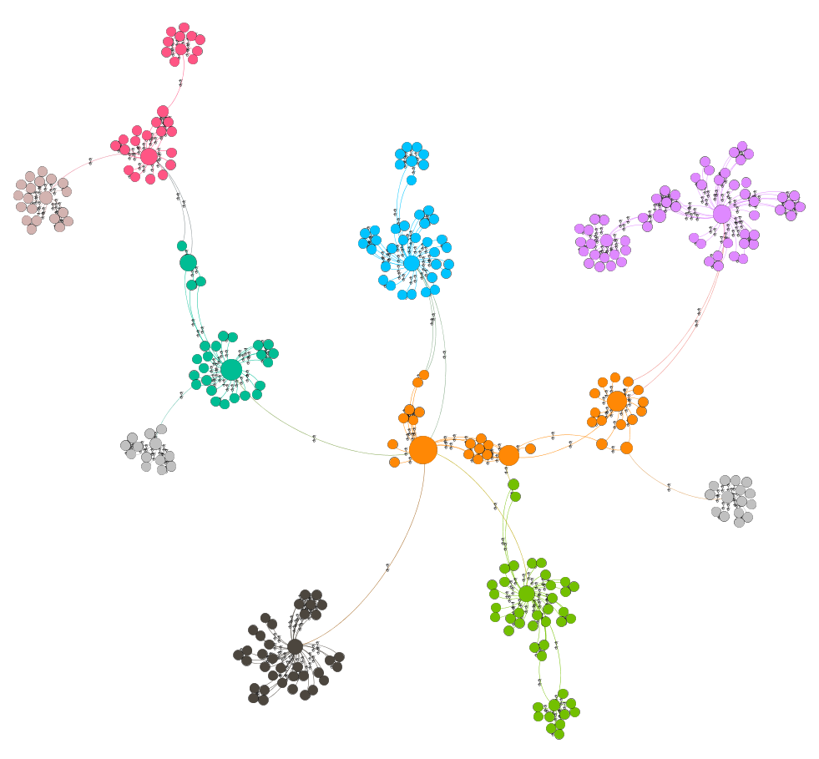
Exploration
Broad scope
Large subset of nodes
Investigates patterns in the data

Slide 13
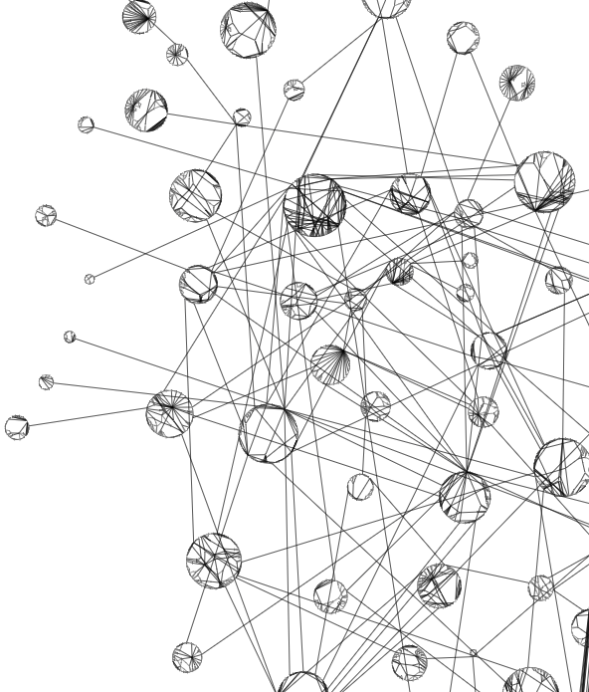
Graph Visualization Best Practices
Develop Iteratively
Determine Use Case
Limit Data
Structure Purposefully
Explore Layouts

Slide 14
Graph Visualization Best Practices
Develop Iteratively
User Feedback
Pertinent Elements
Determine Use Case
Limit Data
Structure Purposefully
Explore Layouts

Slide 15
Super Basic
NetworkX: Drawing graphs

Slide 16
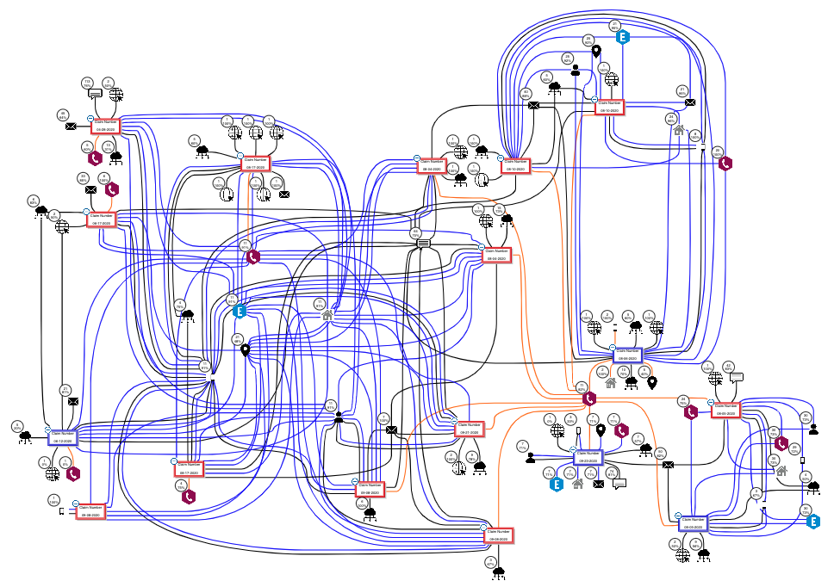
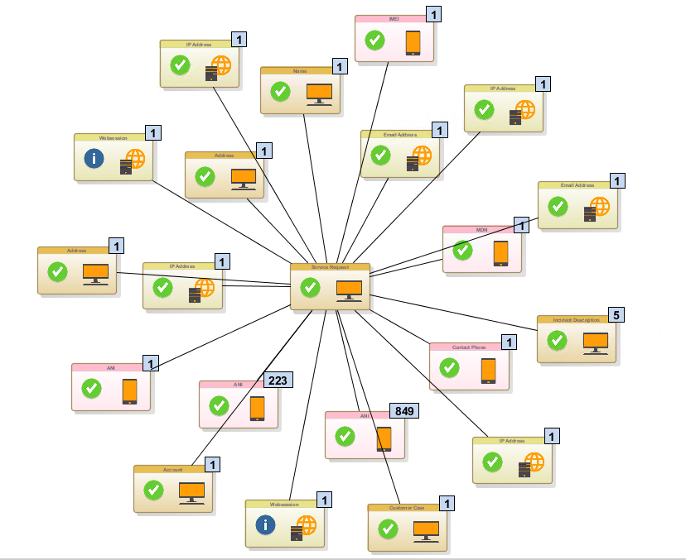
1. Develop Iteratively
Design and features
User Feedback
Pertinent Elements

Slide 17
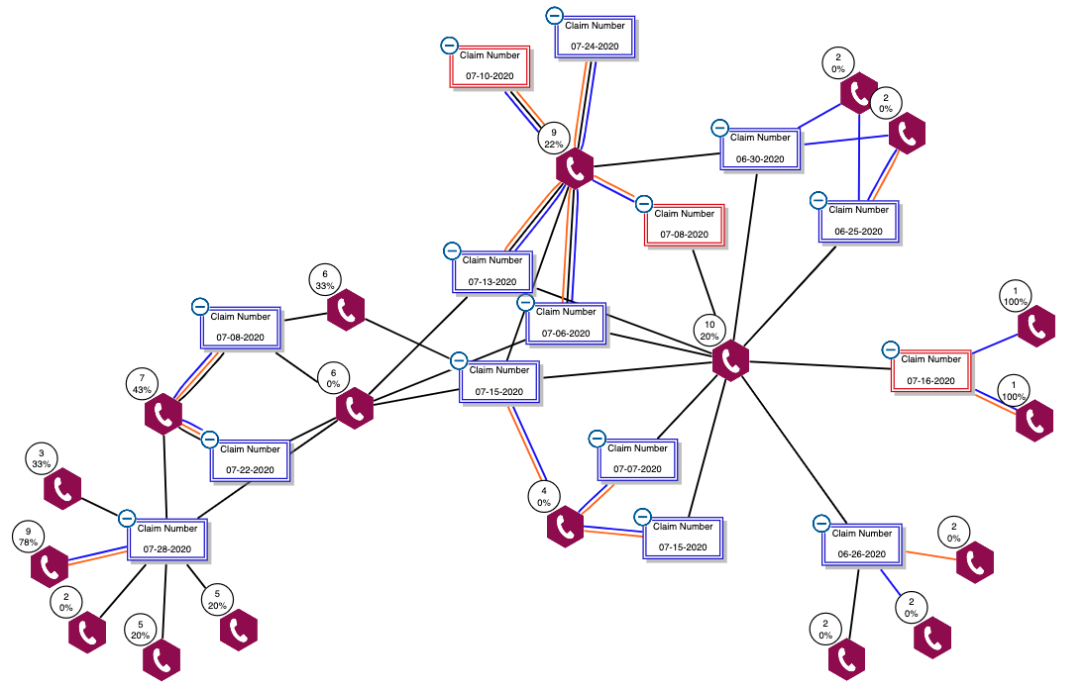
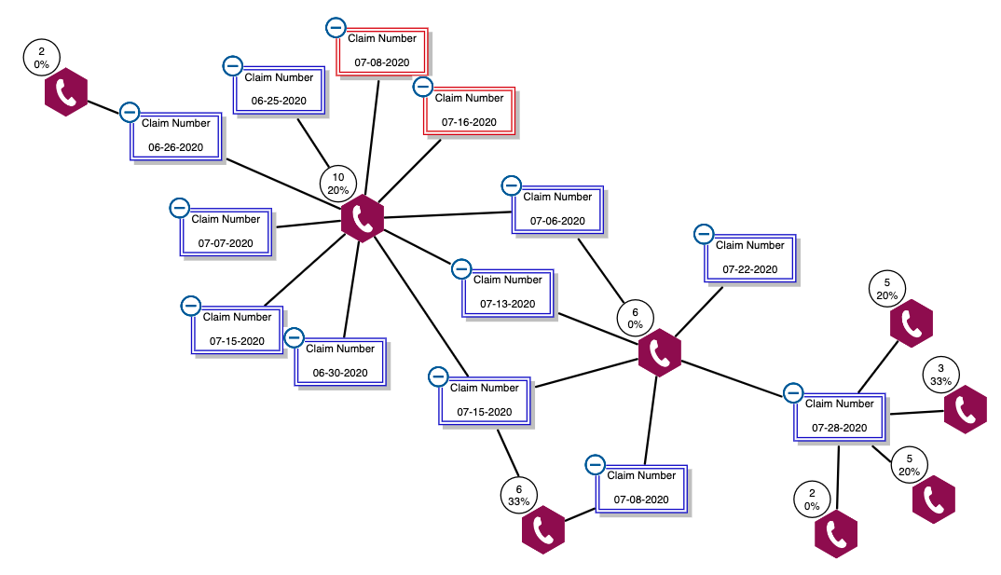
1a. User Feedback
Single connection to phone number
Different types of connection to phone number

Slide 18
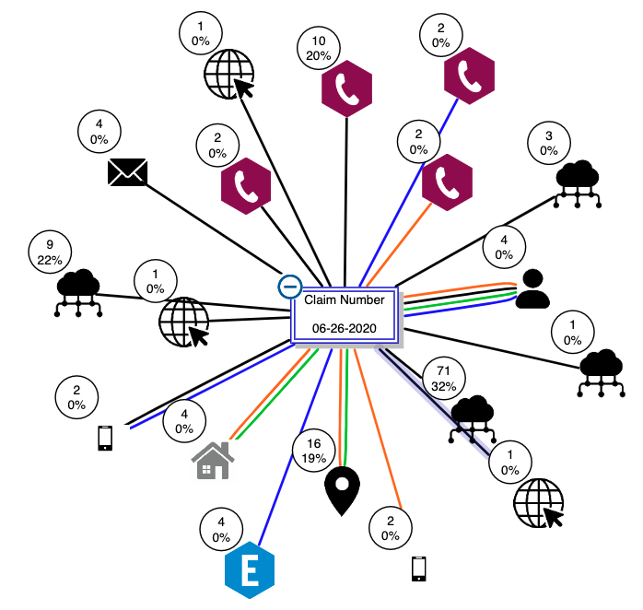
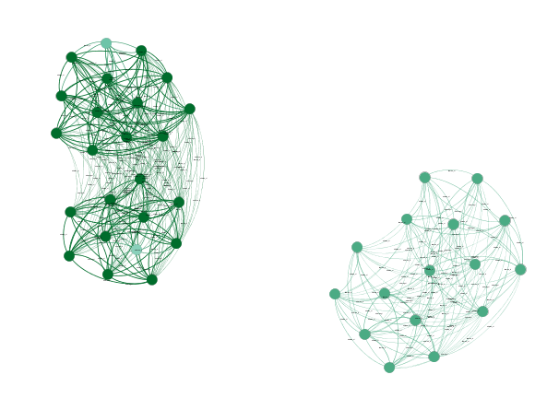
1b. Pertinent Elements
Undifferentiated nodes
Icon differentiated nodes
Icon differentiated nodes and
color-coded relationships

Slide 19
Graph Visualization Best Practices
Develop Iteratively
Determine Use Case
Case Study
Limit Data
Structure Purposefully
Explore Layouts

Slide 20
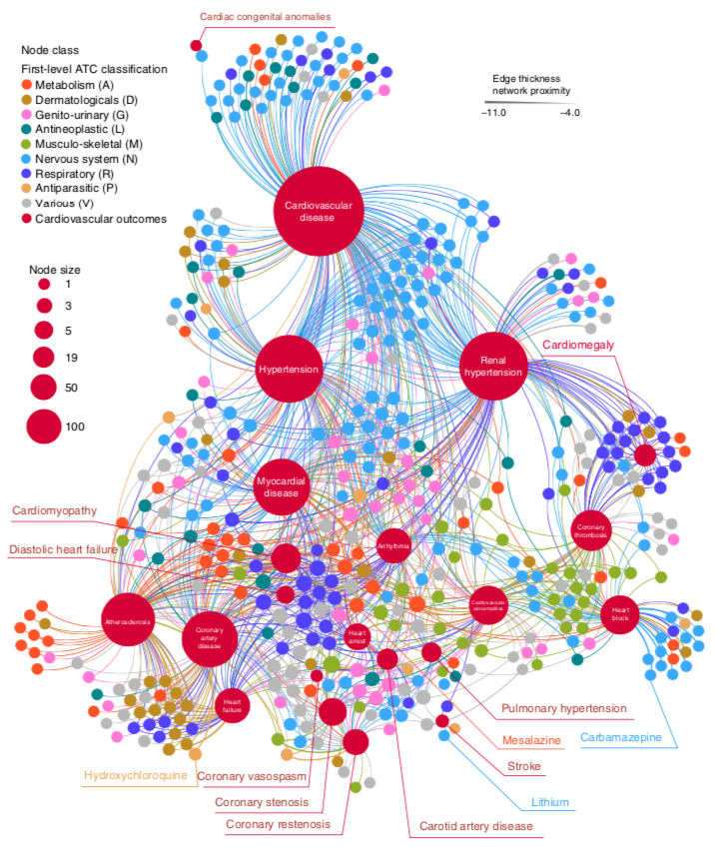
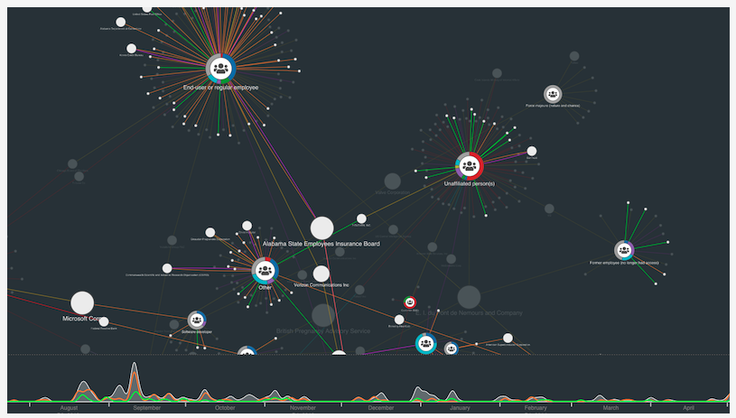
2. Determine Use Case
Network-based approach to prediction and population-based
validation of in silico drug repurposing
Visualizing cyber threat intelligence

Slide 21


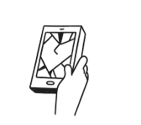
Case Study – Context
Buy Phone
Use Phone
Break Phone

Slide 22
2. Use Case
Network-based approach to prediction and population-based
validation of in silico drug repurposing
Visualizing cyber threat intelligence

Slide 23
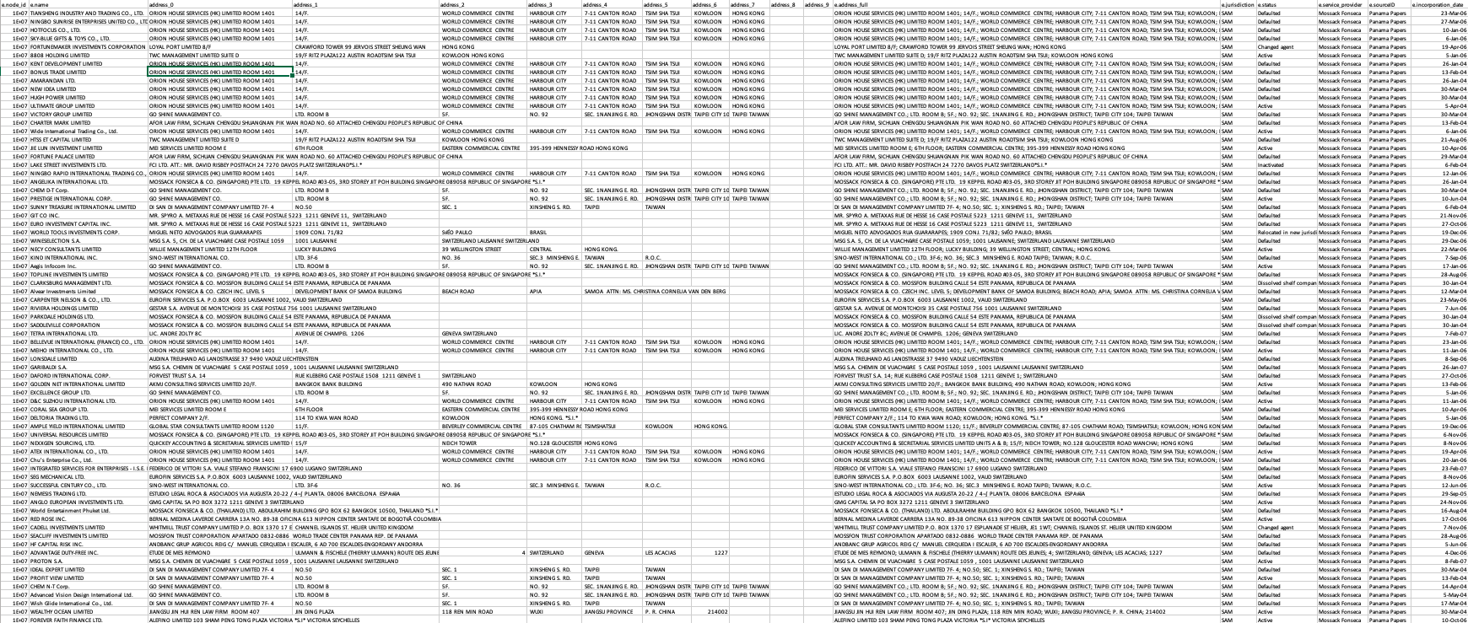
Case Study – Claim Adjudication Tabular Data

Slide 24
Challenge
People Processing Power
Sorting by a single data type:
Difficult to see patterns across multiple data types
Which rows have a cell phone number that matches another row’s home phone number?
Difficult to see how strongly two claims are connected
Which rows share 2 connections?
Rows 1 and 2​
Rows 1 and 4 share IP and email
Row # | Claim ID | Cell Phone | Loss Description | Email | IP | Home Phone
1 | 65478912 | 3095558888 | cracked screen | NA@NA.COM | 1.1.1.1, 5.5.5.5 | 6155556475
2 | 32198745 | 6155556475 | all damaged | NONE@NONE.COM | 2.2.2.2 | 3095558888
3 | 74125896 | 6155559684 | broken screen | ME@CUSTOMER.NET |  | 6155559684
4 | 36925814 | 3035554848 | lost it in the park | NA@NA.COM | 5.5.5.5 | 3035554848

Slide 25
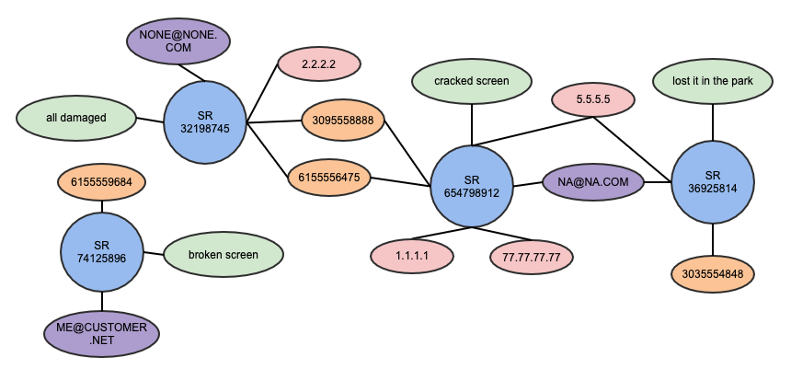
Tabular to Visual
Claim ID | Cell Phone | Loss Description | Email | IP | Home Phone
65478912 | 3095558888 | cracked screen | NA@NA.COM | 1.1.1.1, 5.5.5.5 | 6155556475
32198745 | 6155556475 | all damaged | NONE@NONE.COM | 2.2.2.2 | 3095558888
74125896 | 6155559684 | broken screen | ME@CUSTOMER.NET |  | 6155559684
36925814 | 3035554848 | lost it in the park | NA@NA.COM | 5.5.5.5 | 3035554848

Slide 26
Graph Visualization Best Practices
Develop Iteratively
Determine Use Case
Limit Data
Expand nodes
Filter nodes
Filter relationships
Hide data
Structure Purposefully
Explore Layouts

Slide 27
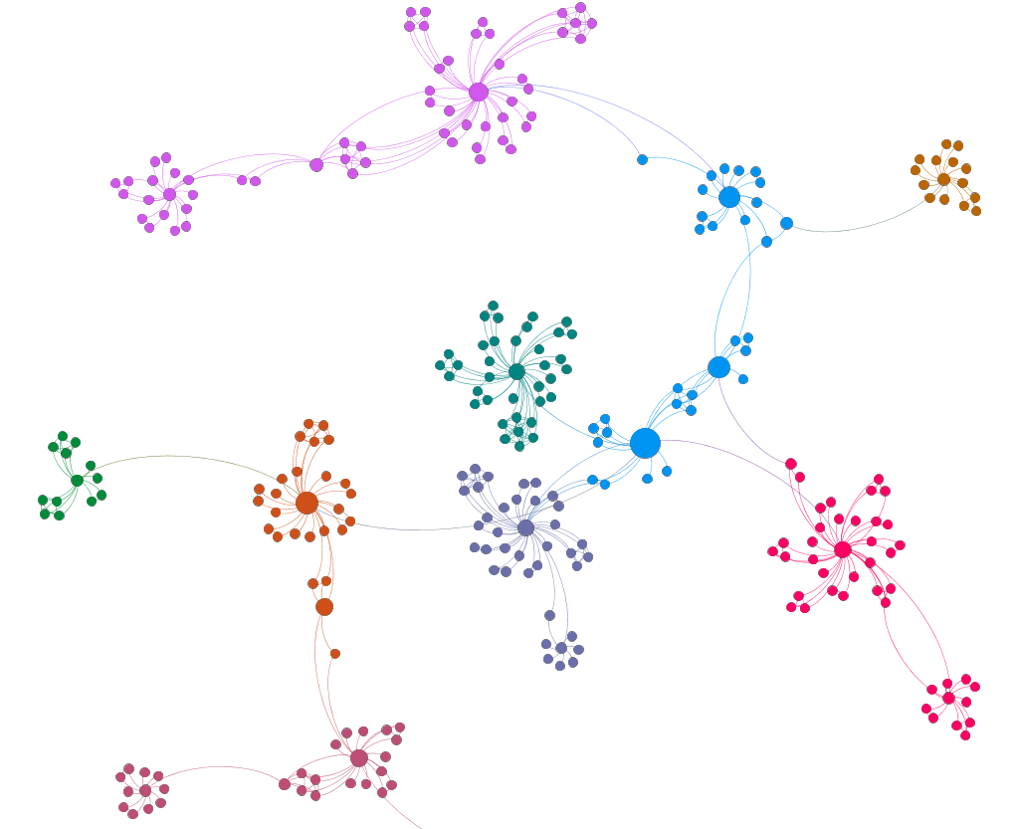
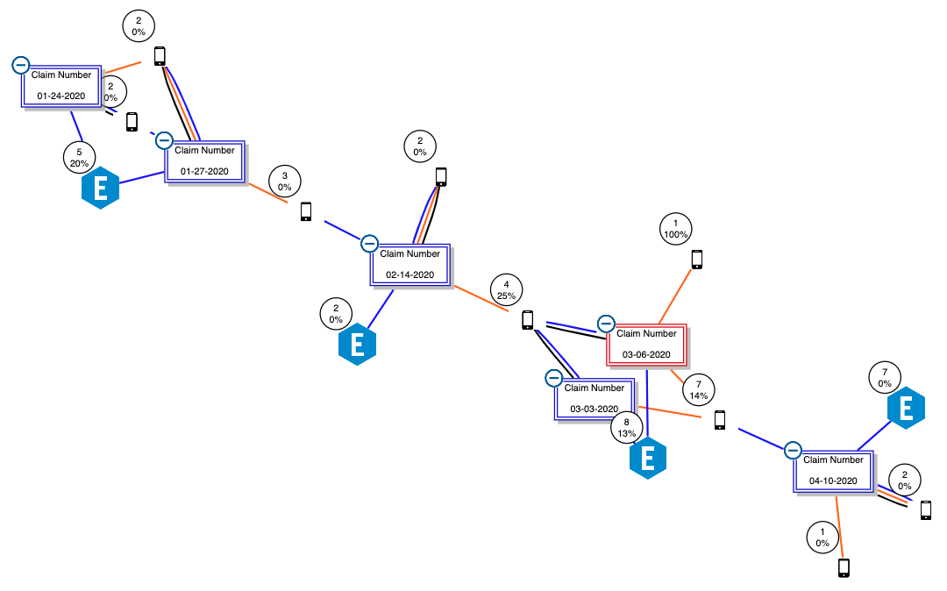
3. Limit Data
IP Addresses – Size: Betweenness Centrality
Account and Device

Slide 28
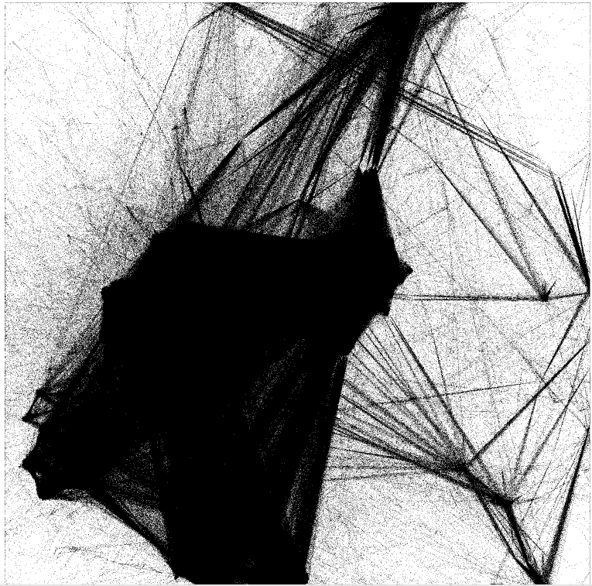
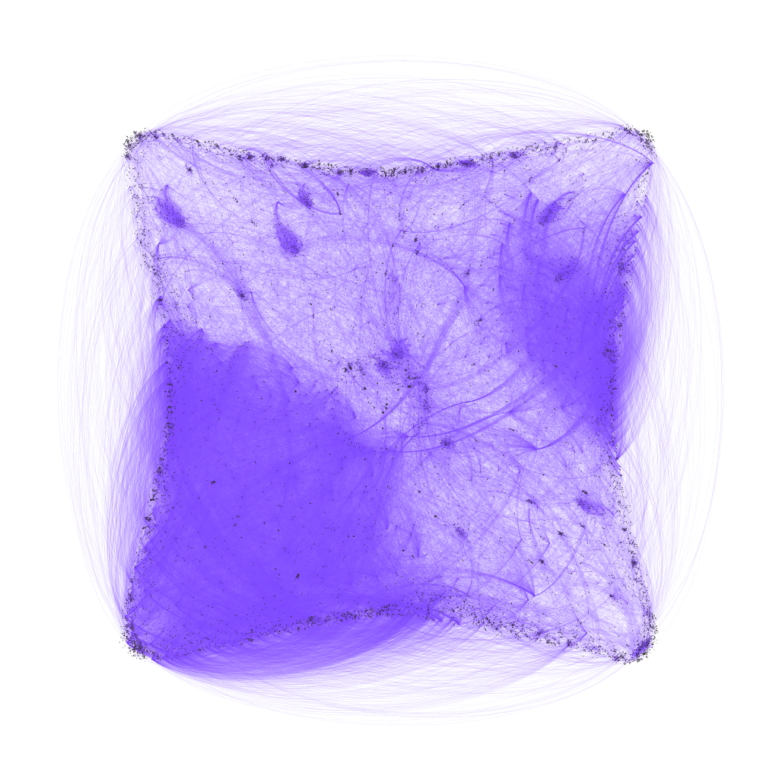
Show Everything
One Week of Claims
Organized Fraud Ring

Slide 29
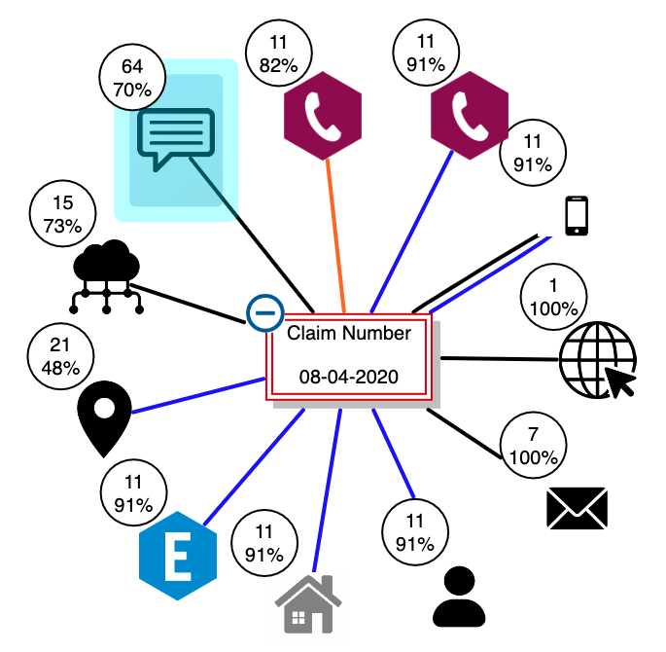
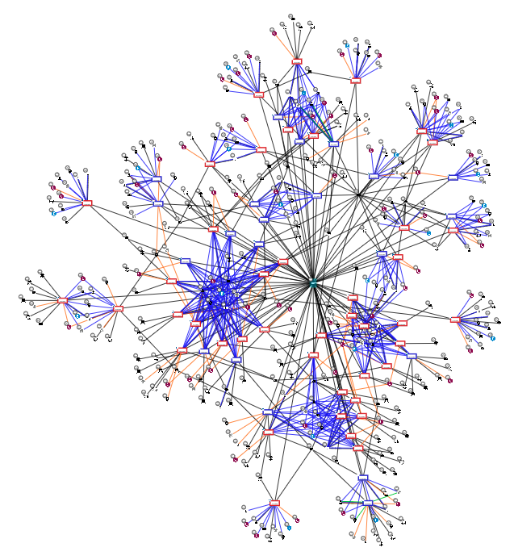
3a. Expand Interesting Nodes
Single node or bimodal node group start
Expand interesting node(s)

Slide 30
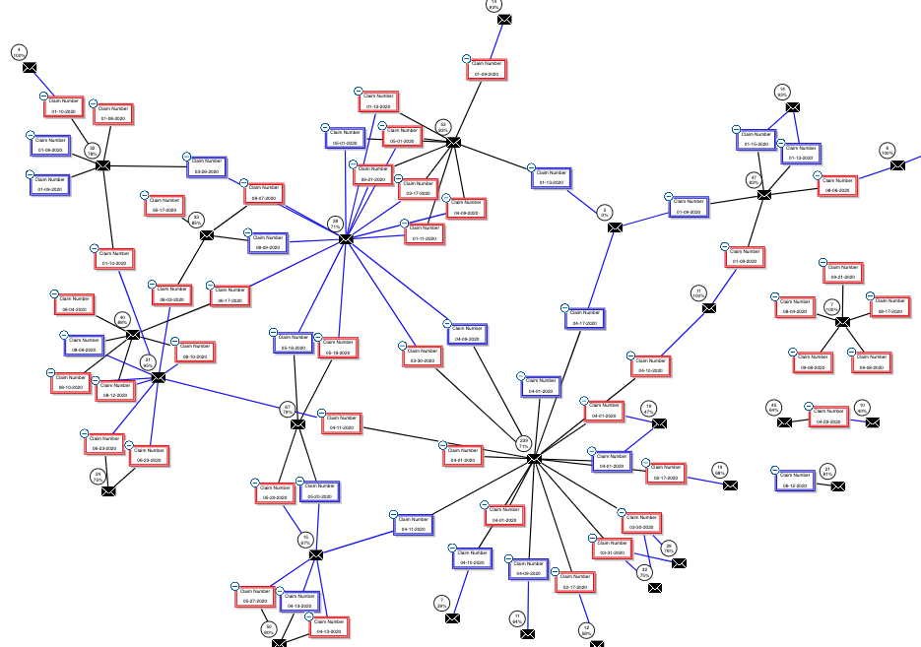
3b. Filter Nodes
Expanded free text
Filtered to email addresses

Slide 31
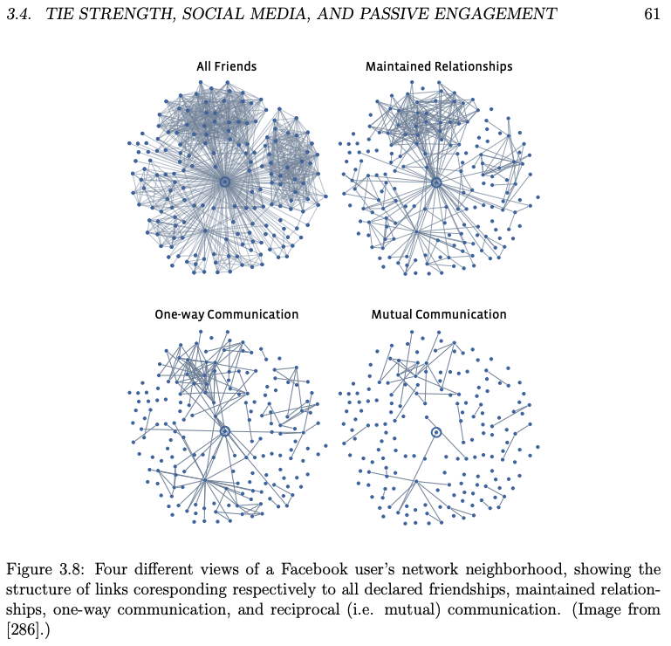
3c. Filter Relationships
Networks, Crowds, and Markets: Reasoning about a Highly Connected World – Chapter 3

Slide 32
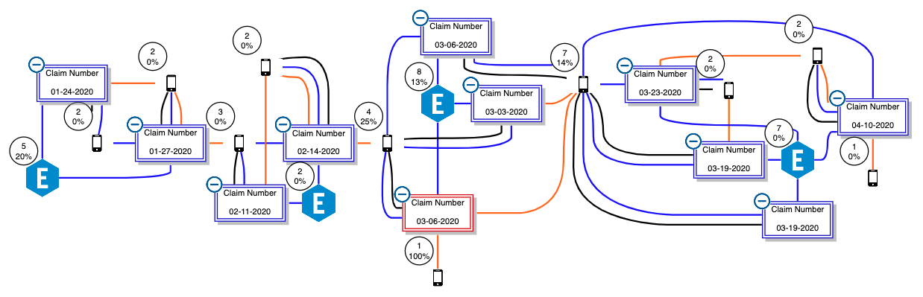
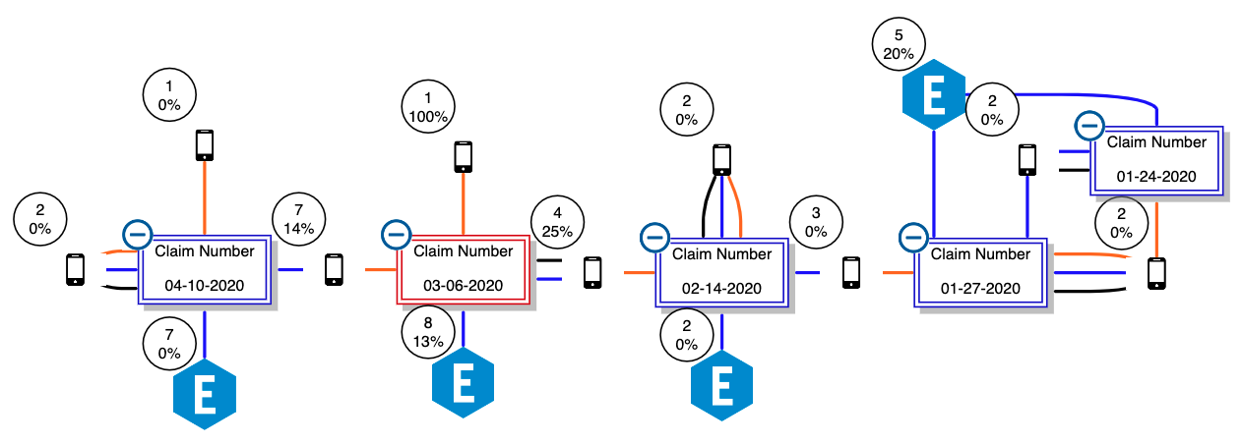
3c. Hide Unwanted Data
Full string of connected devices
Streamlined string of connected devices

Slide 33
Graph Visualization Best Practices
Develop Iteratively
Determine Use Case
Limit Data
Structure Purposefully
Nodes
Relationships
Direction
Explore Layouts

Slide 34
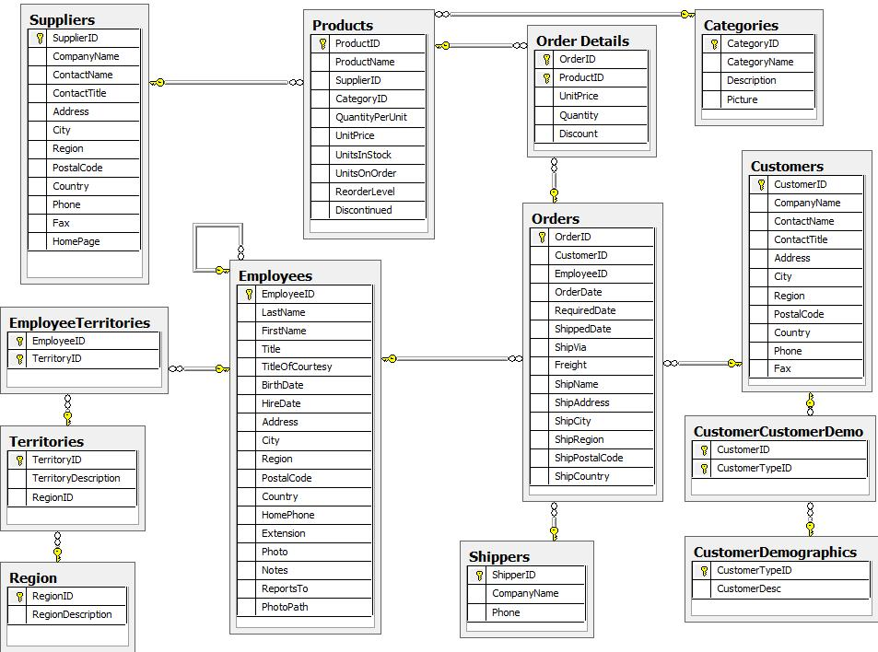
4. Structure Purposefully
The Graph Model is like the Relational Schema. It controls:
Storage
Indexing
Structure
Notes:
Schema photo from: https://neo4j.com/developer/guide-importing-data-and-etl/ - NorthWind dataset

Slide 35
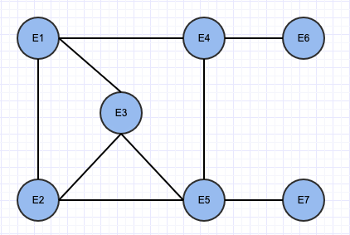
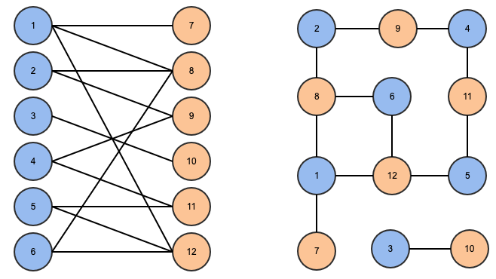
4a. Node Structure
Wanda
Tony
Pepper
People
Club
Knows
Manages
Keeps tabs
Natasha
Friends
Tolerates
Friends
Clint
Friends
Steve
Peggy
Knows
Inspires
Unimodal
Bimodal

Slide 36
4b. Nodes – Examples
Unimodal
Source: Neo4j Marvel Social Graph Algorithms Community Detection
Bimodal

Slide 37
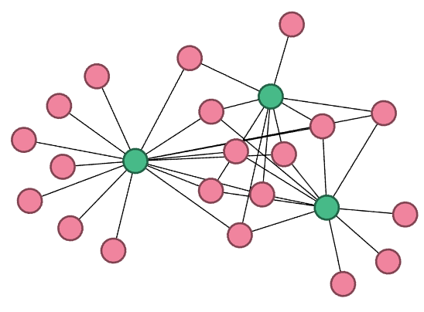
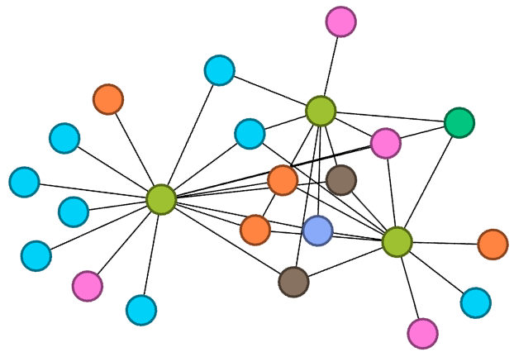
4b. Nodes – Multimodal
Bimodal
Multimodal
Notes:
Multimodal illustration from: https://www.semanticscholar.org/paper/On-the-adaptation-of-a-label-setting-shortest-path-Aur%C3%A9lie-Sophie/3f5e478defdd6f46cb7c06f33be52a3bd5ca1192

Slide 38
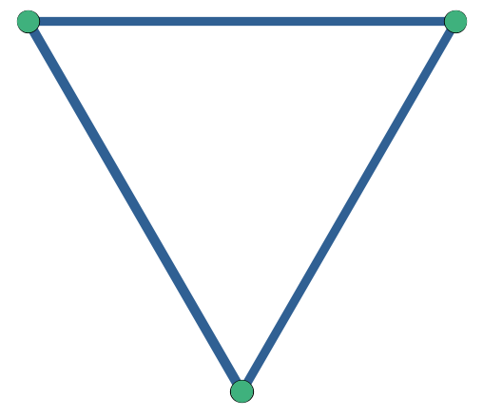
4b. Nodes – Projected Unimodal
Bimodal claim network
Projecting to unimodal network
Notes:
Multimodal illustration from: https://www.semanticscholar.org/paper/On-the-adaptation-of-a-label-setting-shortest-path-Aur%C3%A9lie-Sophie/3f5e478defdd6f46cb7c06f33be52a3bd5ca1192

Slide 39
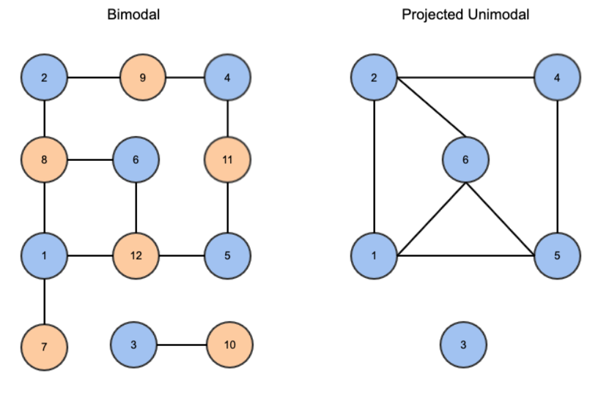
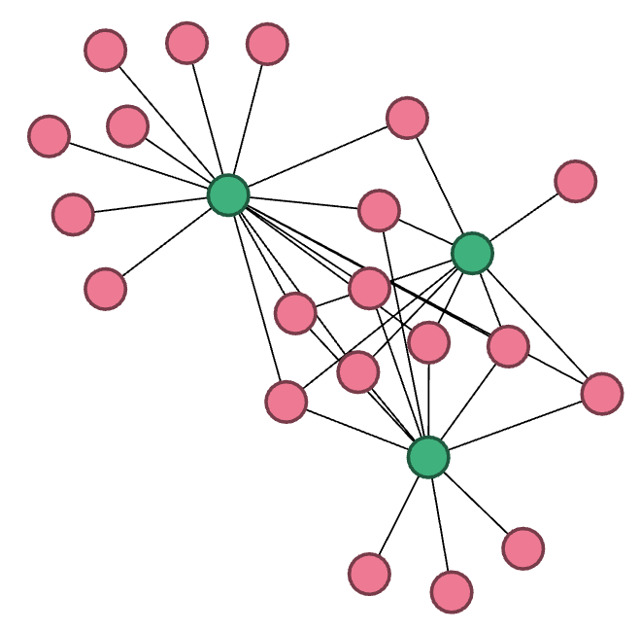
4b. Nodes – Projected Unimodal
Wanda
Wanda
Natasha
Natasha
Clint
Clint
Unimodal to bimodal
Projecting bimodal claim network to unimodal
Notes:
Multimodal illustration from: https://www.semanticscholar.org/paper/On-the-adaptation-of-a-label-setting-shortest-path-Aur%C3%A9lie-Sophie/3f5e478defdd6f46cb7c06f33be52a3bd5ca1192

Slide 40
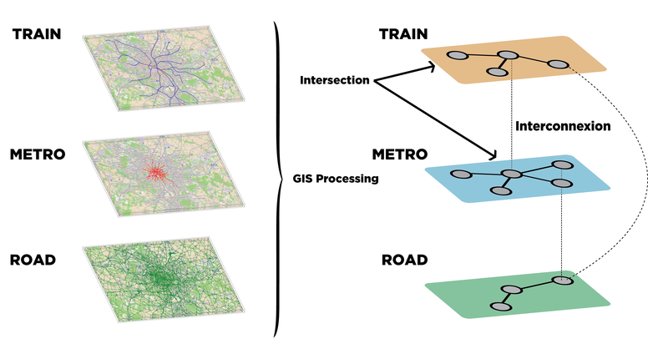
4b. Nodes – Multilayer
Aggregation of multi Layered Graph of public Transport
Notes:
Multimodal illustration from: https://www.semanticscholar.org/paper/On-the-adaptation-of-a-label-setting-shortest-path-Aur%C3%A9lie-Sophie/3f5e478defdd6f46cb7c06f33be52a3bd5ca1192

Slide 41
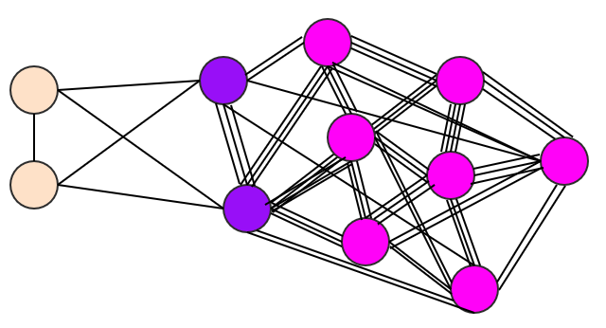

4c. Relationships
Pepper
Pepper
Natasha
Natasha
Wanda
Wanda
Multigraph
Singular or Weighted

Slide 42
4c. Relationships
Multigraph
Singular or Weighted

Slide 43

4c. Direction
Undirected
Facebook friends Two-way streets
Directed
Twitter followers One-way streets
Notes:
Schema photo from: https://neo4j.com/developer/guide-importing-data-and-etl/

Slide 44

4c. Direction – PageRank
PageRank from Wikipedia
Notes:
Multimodal illustration from: https://www.semanticscholar.org/paper/On-the-adaptation-of-a-label-setting-shortest-path-Aur%C3%A9lie-Sophie/3f5e478defdd6f46cb7c06f33be52a3bd5ca1192

Slide 45

4b. Direction – cont’d
08-19-2020
07-28-2020
08-19-2020
07-28-2020
08-21-2020
08-21-2020
Undirected – projected unimodal
Directed – time series weighted projected unimodal
Notes:
Schema photo from: https://neo4j.com/developer/guide-importing-data-and-etl/

Slide 46
Graph Visualization Best Practices
Develop Iteratively
Determine Use Case
Limit Data
Structure Purposefully
Explore Layouts
Force direction
Layouts
Combos
Bundling

Slide 47



5. Explore Layouts
Starting spacing in Gephi
Nodes packed into a circle
Yifan Hu Layout in Gephi

Slide 48


5a. Force Direction
Tightly packed node cluster – hairball network
Node cluster after applying data limiting techniques

Slide 49
5a. Force Direction – cont’d
Force-directed layout in Tom Sawyer
Force-directed layout in Gephi

Slide 50



5b. Layouts

Slide 51


5c. Combos Cambridge-Intelligence’s combo feature as demonstrated on their Combining and grouping nodes page.
Individual nodes with relationships
Combined nodes and relationships

Slide 52
5c. Combos – Example
Multiple claims under the same account
Grouping nodes under the same account

Slide 53


5d. Bundling Bundling airplane flights as demonstrated in the paper Edge Bundling in Information Visualization.
All edges travel separately to their designated node
Edges going in similar directions are bundled together

Slide 54
Not All Visualizations are Created Equal
Develop Iteratively
Determine Use Case
Limit Data
Structure Purposefully
Explore Layouts

Slide 55
Graph Visualization Software
NetworkX
Gliffy
Gephi
Cambridge Intelligence
Tom Sawyer

Slide 56
Resources
Books, Articles, and Blogs
Networks: An Introduction Second Edition by Mark Newman
Graph Algorithms: Practical Examples in Apache Spark & Neo4j by Mark Needham and Amy E. Hodler
Visualizing Graph Data by Corey L. Lanum
Networks, Crowds, and Markets by David Easley and Jon Kleinberg
Network Science by Albert-László Barabási
Barabási Lab
Albert-László Barabási Publications webpage
Neo4j Blog
Neo4j: Graph Visualization Tools
Static and dynamic network visualization with R by Katya Ognyanova
From Data to Viz
Flowingdata.com
Visualization Tools and Software
Cambridge Intelligence
Tom Sawyer Software
Gephi
Linkurious
D3 Network graph
Cytoscape.js
NetworkX
Vis Network
Plotly and Dash
Reading list for data visualization

